Slide 1
Machine Learning Approaches for Predicting Cardiovascular Diseases
Presented By:
Name: Muqaddas Salahuddin
Team Leader

Slide 2
Team Members:
Muqaddas Salahuddin
Saad Ali khan Gondal
Tehreem Fatima
Amina Shahid
Muhammad Hamza
Rashid Mehmood

Slide 3
Outlines
Introduction
Problem Statement
Research Objectives
Research Work
Data Collection
Results
Conclusion

Slide 4
Introduction
Cardiovascular diseases remain a major global health concern, requiring improved detection methods. This research applies machine learning to predict conditions like myocardial infarction, addressing the issue of imbalanced datasets. Using models such as Fuzzy C-Means, Quadratic Discriminant Analysis (QDA), Support Vector Machine (SVM) , Multi-layer Perceptron (MLP), and Stochastic Gradient Descent (SGD), the study evaluates their performance. The study explores the performance of these classifiers and provides meaningful data for designing effective myocardial infarction prediction models. The results show how these machine learning techniques can enhance the ability to diagnose cardiovascular disorders.

Slide 5
Problem Statement
Developing and improving prediction models for Cardiovascular disease (CVD) risk assessment is essential given the rising prevalence of cardiovascular diseases worldwide and the promise of ML for early diagnosis. However, to guarantee dependable and therapeutically beneficial ML applications, issues like data limits, model understanding.

Slide 6
Tools & Technologies Used
Programming Language (Python 3.x)
Development Environment (Google Colab)
Data Handling & Processing (Pandas, NumPy)
Data Visualization (Matplotlib, Seaborn)
Machine Learning Libraries (Scikit-Learn)

Slide 7
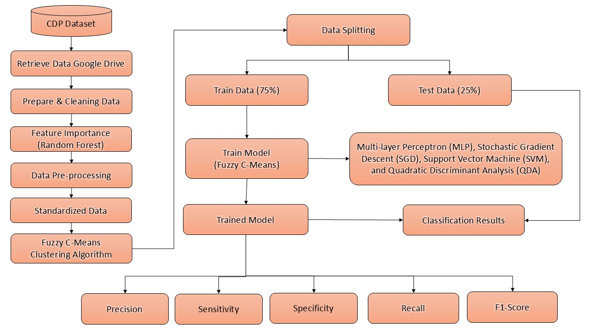
Research Work

Slide 8
Data Collection
Information on this popular ML dataset website Kaggle provides the Cardiovascular disease (CVD) dataset. It was previously used [19]. There are thirteen variables, which include relevant characteristics and symptoms associated with cardiovascular disease, that define each of the 70,000 instances in this dataset. The outcome status of the dataset indicates two target classes: non-cardiovascular (35,021 cases) and cardiovascular (34,979 instances) [41]. In light of its large body of health and demographic information, the CDP dataset is a useful resource when performing extensive medical studies and developing model forecasts for healthcare analytics.

Slide 9
Parameters of the Dataset
Parameters of the Dataset | Characteristics of CDP
Age | Patient age
Height | Patient height
Weight | Patient weight
Gender | Patient Sex: female; male
Systolic blood pressure | Have you ever been fatigued, worn out, or exhausted?
Diastolic blood pressure | Have you frequently experienced ineffective coughing?
Cholesterol | Have you ever felt suffocated or out of breath?
Glucose | Have you ever felt a sore, itchy, or painful throat?
Smoking | Have you had frequent bone or body pain?
Alcohol Intake | Have you ever felt your face or nose feel full?
Physical Activity | Have you ever had fluids flow down your mouth or drip?
Cardiovascular Disease | Patient Severity; None, Mild or Moderate.
Table 2: Shows the Original Cardiovascular Disease Prediction Dataset

Slide 10
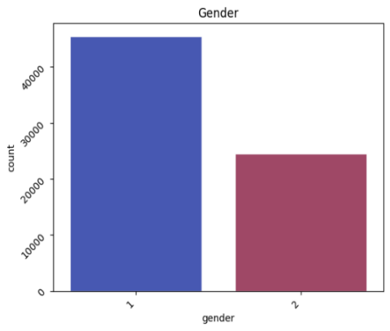
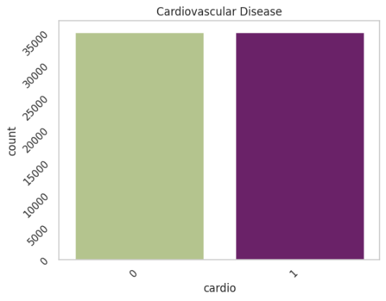
Data Collection
A comparison of men's and women's prevalence of CVD is depicted in 1st Figure. The x-axis indicates gender, with 1 representing females and 2 representing males. In 2nd Figure indicates how patients with cardiovascular condition are distributed across a number of classes. These are represented on the x-axis, ranging from 0 for non-cardiovascular cases to 1 for cardiovascular instance.
Quantity of Facts Male and Female Cardiovascular Disease Patients
Quantity of Cardiovascular Disease Patients

Slide 11
Results and Discussion
The research evaluated how the models generated by the use of ML methods performed in binary classification. To contrast performances, the following metrics were calculated: recall, precision, accuracy, F1-score, Confusion matrix, Accuracy, and ROC-AUC. The identification of the best results is the aim of the performance measures for the methods for ML being used.

Slide 12
Model Parameters:
A 75% training set and 25% test set were pulled from the CVD dataset for the research. The seed parameter was fixed at "1234" to ensure that the test and training sets to be used by the preceding models were the same. Additionally, the cross-validation procedure in the study comprised splitting the training and test sets ten times into 75% and 25%, each time having different data, and taking the average of the results. Usually, the default values were used in the developed algorithms. However, except for the default parameter values, the other parameters' values were inputted.

Slide 13
FEATURE SELECTION
Feature significance rates a model's input attributes according to their relevance. While lower-scoring features can be eliminated to reduce dimensionality and improve model performance and efficiency, higher-scoring elements have a major influence on predictions. Utilizing techniques such as XGBoost, SVM, and RF are used to iteratively remove less significant features according to their significance. In contrast to conventional techniques, this method improves efficiency and forecast accuracy by precisely selecting features through the use of strategic considerations and mathematical calculations.

Slide 14
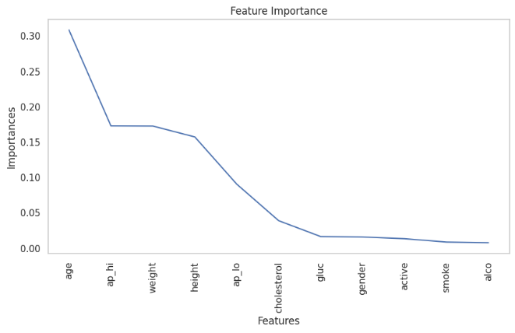
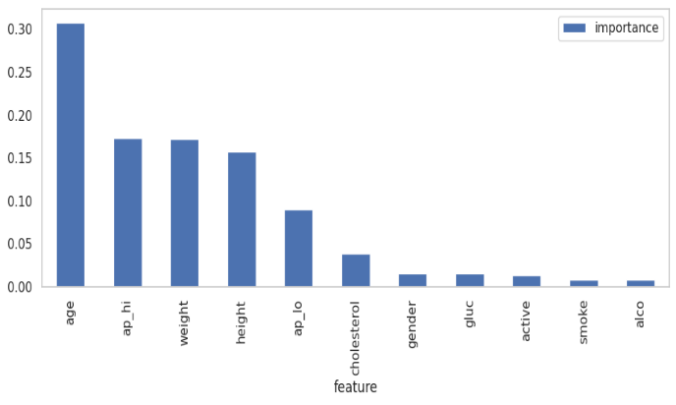
FEATURE SELECTION
Feature Importance Dataset

Slide 15
FEATURE SELECTION
Sr. No. | Feature | Feature Importance Score
1 | age | 0.308162
2 | ap_hi | 0.172671
3 | weight | 0.172423
4 | height | 0.157008
5 | ap_lo | 0.090245
6 | cholesterol | 0.038594
7 | gluc | 0.016222
8 | gender | 0.015581
9 | active | 0.013170
10 | smoke | 0.008399
11 | alco | 0.007525
Cardiovascular Disease Prediction Dataset with Feature Importance (CDP)

Slide 16
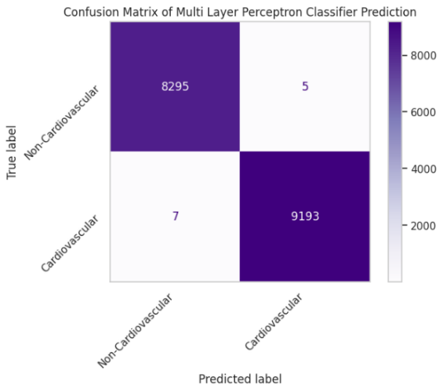
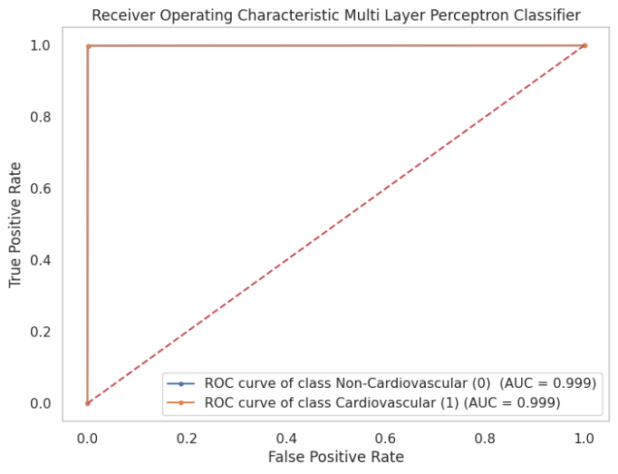
Multi-Layer Perceptron Algorithm
Multi-Layer Perceptron (MLP) Confusion Matrix Algorithm
Multi-Layer Perceptron's (MLP) Receiver Operating Characteristic (ROC) Curve

Slide 17

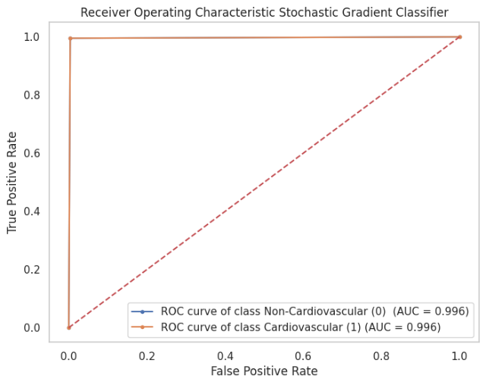
Stochastic Gradient Descent Algorithm
Stochastic Gradient Descent (SGD) Confusion Matrix Algorithme
Stochastic Gradient Descent (SGD) Receiver Operating Characteristic Curve

Slide 18

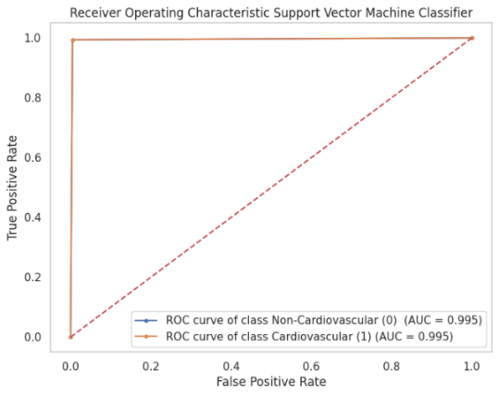
Support Vector Machine Algorithm
Support Vector Machine (SVM) Confusion Matrix Algorithm
Support Vector Machine (SVM) Receiver Operating Characteristic (ROC) Curve

Slide 19
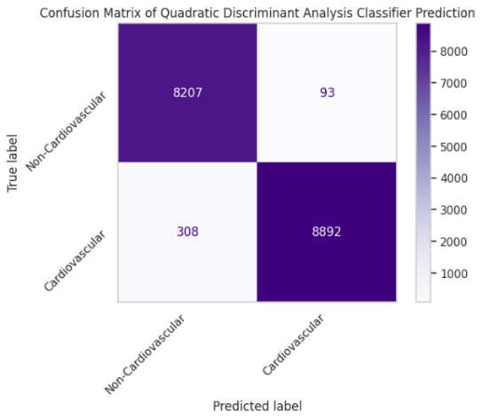
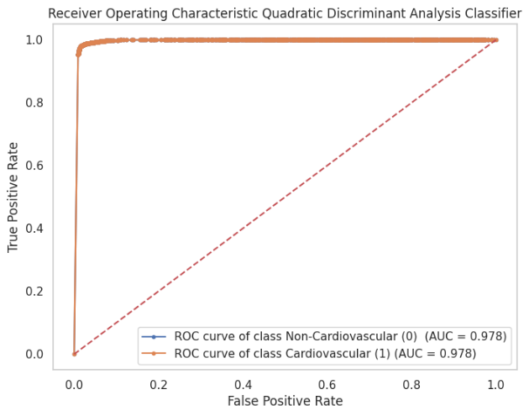
Quadratic Discriminant Analysis (QDA) Algorithm
Quadratic Discriminant Analysis (QDA) Receiver Operating Characteristic (ROC) Curve
Quadratic Discriminant Analysis (QDA) Confusion Matrix Algorithm

Slide 20
RESULTS AND DISCUSSION:
Hybrid Algorithm | Accuracy of Algorithms
Fuzzy C-Means, Multi-layer Perceptron (MLP) Proposed Method | 99.9314 %
Fuzzy C-Means, Stochastic Gradient Descent (SGD) Proposed Method | 99.5771 %
Fuzzy C-Means, Support Vector Machine (SVM) Proposed Method | 99.4571 %
Fuzzy C-Means, Quadratic Discriminant Analysis (QDA) Proposed Method | 97.7085 %

Slide 21
RESULTS AND DISCUSSION:
S/No. | Parameter Score | Multi-layer Perceptron (MLP) | Stochastic Gradient Descent (SGD) | Support Vector Machine (SVM) | Quadratic Discriminant Analysis (QDA)
1 | Precision | 0.99930661 | 0.99572639 | 0.99450991 | 0.97673897
2 | Recall | 0.99931836 | 0.99579557 | 0.99460712 | 0.97765845
3 | F1-Score | 0.99931247 | 0.99576051 | 0.99455757 | 0.97705055
4 | Sensitivity | 1.0 | 1.0 | 1.0 | 1.0
5 | Specificity | 1.0 | 1.0 | 1.0 | 1.0

Slide 22
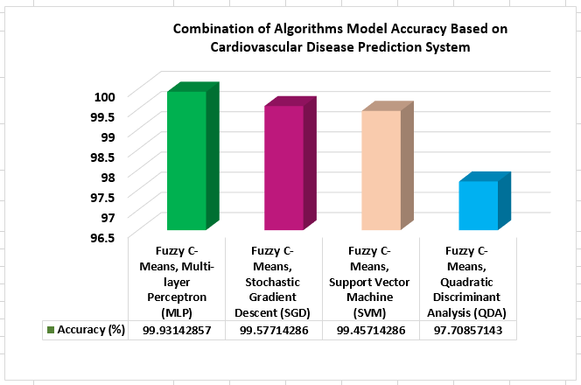
Algorithm Combination Model Accuracy for Predicting Cardiovascular Disease
Combination of Parameter Score and Algorithms for Predicting Cardiovascular Disease (CDP)

Slide 23
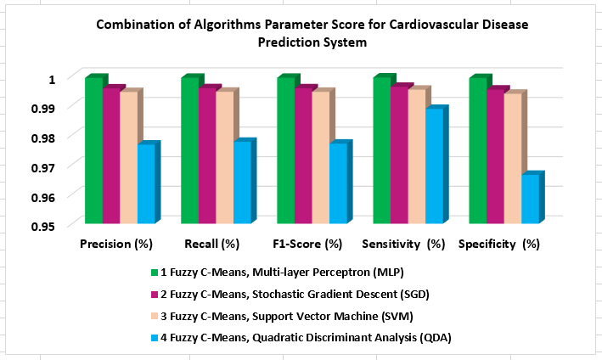
Combination of Algorithms Parameter Score for Predicting Cardiovascular Disease
Combination of Algorithms Parameter Score for Predicting Cardiovascular Disease

Slide 24
CONCLUSION
In the study's conclusion, a technique that helps doctors correctly diagnose cardiovascular diseases and heart illness is presented. We applied several ML techniques, such as fuzzy C-Means clustering, MLP, SGD, SVM, and QDA, using datasets that contained cardiovascular disease (CVD) data. The combination of fuzzy C-Means and MLP yielded the greatest accuracy rate of 99.93%, demonstrating the tremendous efficiency of these categorization techniques. Accuracy values of 99.93% for MLP, 99.58% for with SGD, 99.46% for SVM, and 97.71% for QDA were obtained by combining each method with Fuzzy C-Means.

Slide 25
THANK YOU FOR
YOUR TIME TODAY

